Slide 1
Tab 1

Slide 2

2026 Strategic Growth C Performance Review Driving Excellence in the Printer Department G Obaakran Branch Flagship Operations
DATA ANALYSIS FOR 2026 STRATEGIC PLANNING BY EMMANUEL ADEKOYA FOR WESTGATE
Introduction
Vision: To be the ICT one-stop shop of choice.
Mission: Quality service delivered with warmth, friendliness, and individual pride.

Slide 3
Slide 2: Executive Summary – The State of the Business
Content: * Overview: 2025 showed a pivot from general hardware to specialized solutions.
Total Printer Revenue Growth: Strong upward trend led by Adepele and Online sectors.
Obaakran Status: Remains the high-volume engine of the company, though category shifts are occurring.
Honest Assessment:
  Working: B2B loyalty and "Tank" system adoption.
  Not Working: Laptop margins in Obaakran are tightening; South-East printer sales (Enugu/PH) face supply chain friction.
2

Slide 4
Tab 2

Slide 5
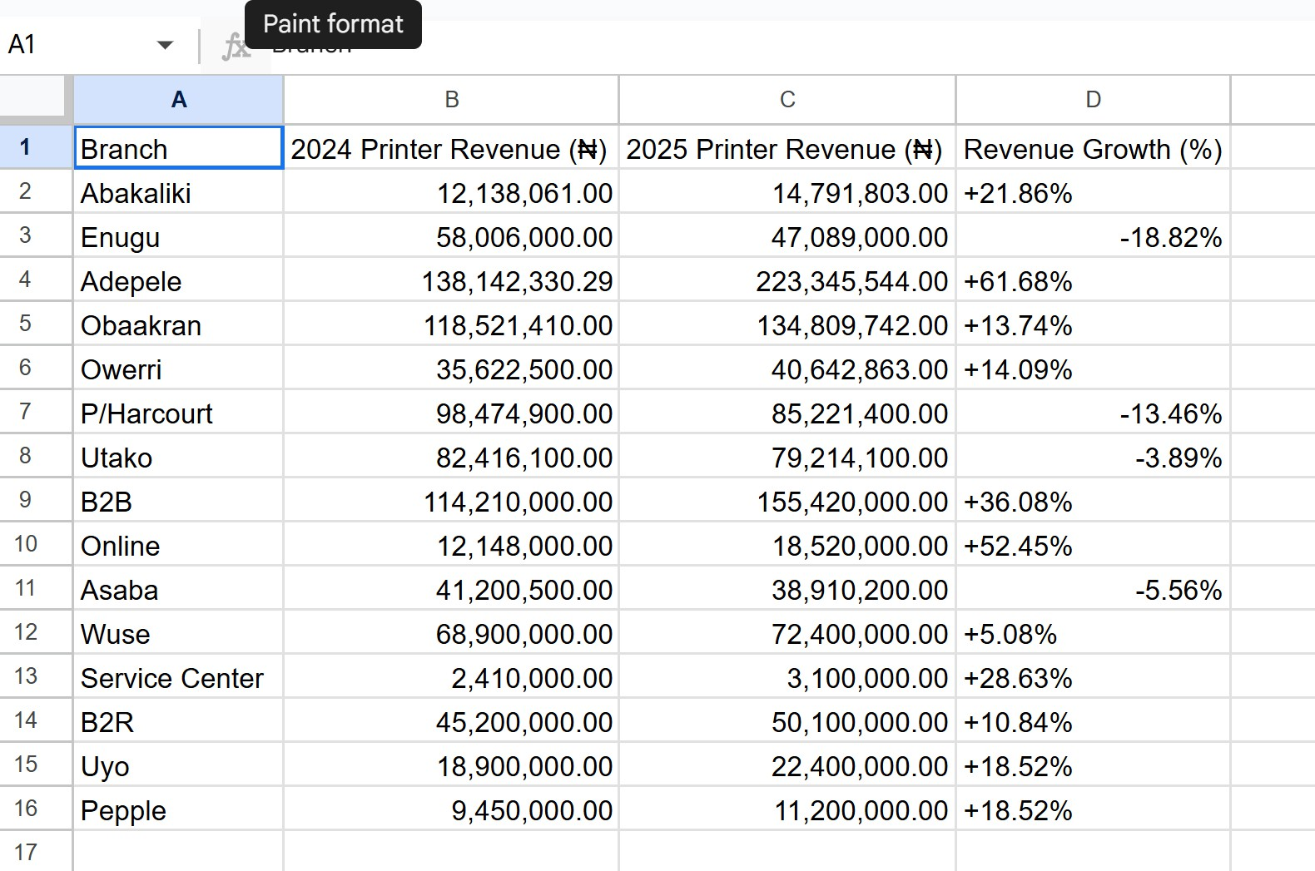
Slide 3: Printer Department – National Performance Overview
Visual: Clustered Column Chart (2024 vs 2025) Data Points:
Adepele: ₦138.1M → ₦223.3M (+61.7%)
Online: ₦12.1M → ₦18.5M (+52.4%)
B2B: ₦114.2M → ₦155.4M (+36.1%)
Underperformers: Enugu and P/Harcourt (Needs immediate tactical support). Key Takeaway: Growth is centralizing in high-efficiency hubs and digital channels.

Slide 6
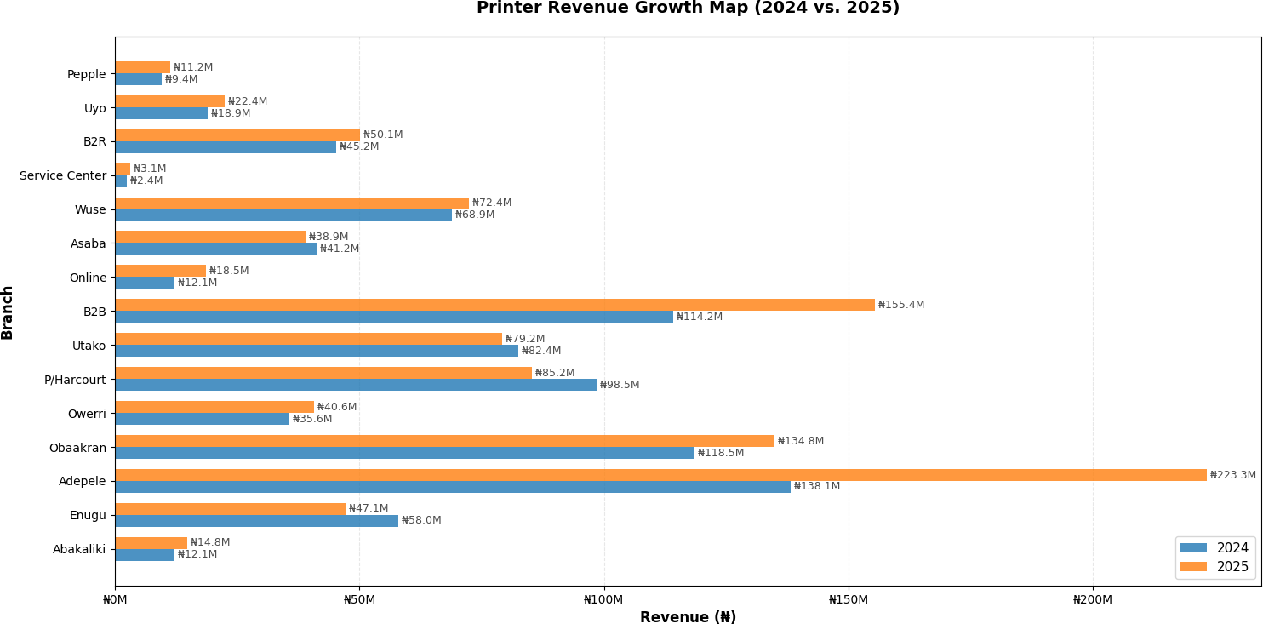

Slide 7
Tab 3

Slide 8
Slide 4: Printer Department – Strategy Reset Workshop
Visual: SWOT Matrix * Strengths: Authorized dealership status; 15-branch support network.
Weaknesses: Consumable "Leakage" (Customers buy printers but source ink elsewhere).
Opportunities: Managed Print Services (MPS) for B2B; Subscription-based ink replenishment.
Market Insight: Customers are prioritizing Total Cost of Ownership (TCO) over initial purchase price.

Slide 9
Tab 4

Slide 10
Slide 5: Printer Department – 2026 Roadmap
Content:
2026 Strategy: Transition from "Printer Sales" to "Total Print Solutions."
KPIs:
  Attach Rate: 80% (Spare Ink/Toner sold with every unit).
  Service Leads: 15% conversion from Service Center repairs to new unit upgrades.
Timeline: * Q1: Roll out "Ink-Link" Loyalty Program.
  Q2: B2B Regional Roadshows (Owerri/Asaba).
Resource Needs: Dedicated "Consumable Inventory App" to track toner levels for B2B clients.

Slide 11
Tab 5

Slide 12
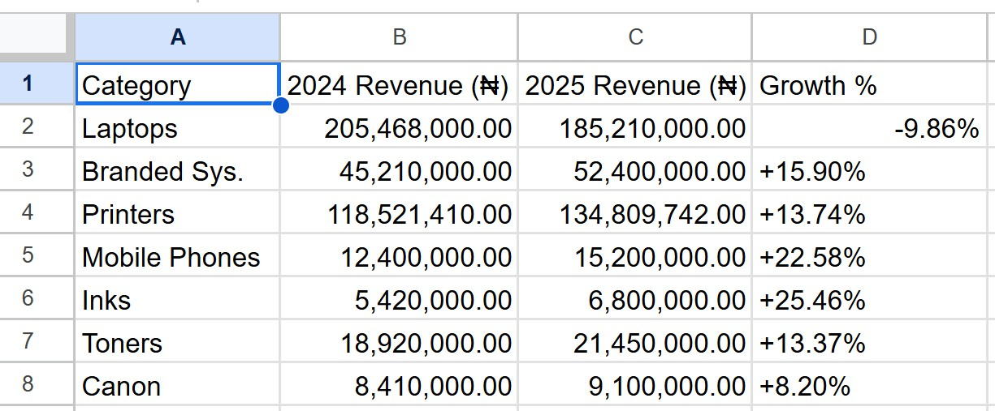
Slide 6: Obaakran Branch – Full Product Performance
Visual: Waterfall Chart of Category Growth Category Performance (2024-2025):
Inks: +25.5% (The new profit anchor).
Mobile Phones: +22.6%.
Printers: +13.7%.
Laptops: -9.8% (High competition/Price wars). Insight: Obaakran is successfully diversifying away from low-margin laptops into high-margin consumables and mobiles.

Slide 13
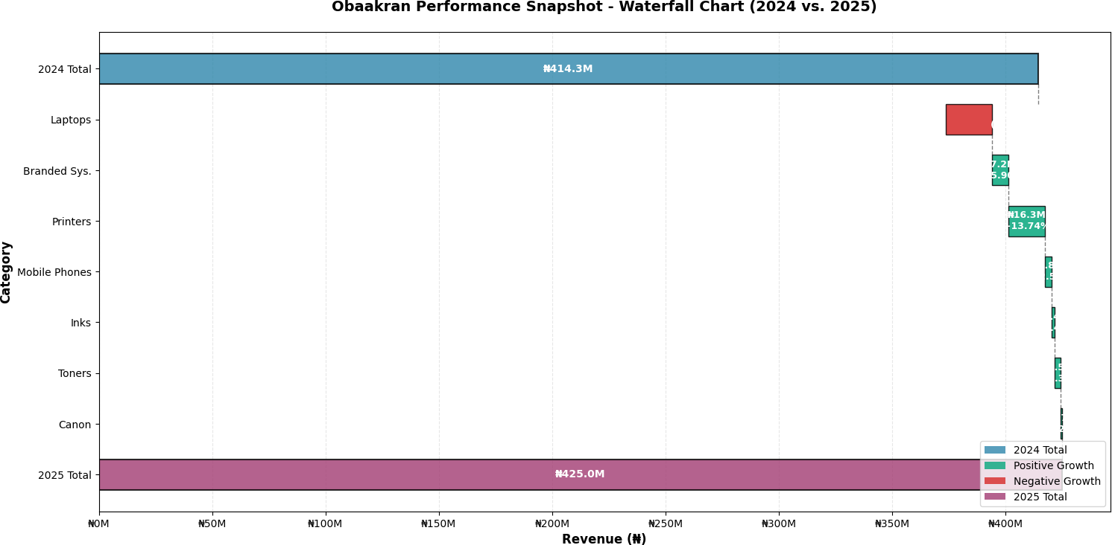

Slide 14
Tab 6

Slide 15
Slide 7: Obaakran Branch – Strategic Assessment
Content:
Identified Gaps: Peak hour congestion reduces "Warmth and Friendliness" (Mission impact).
Opportunity: The "Creator Economy." Content creators in Lagos need specialized Canon gear and high-end printing.
Market Challenge: Price pressure from Computer Village.
The "One-Stop" Solution: Focus on Warranty and Aftersales as the differentiator, not just the price tag.

Slide 16
Tab 7

Slide 17
Slide 8: Obaakran Branch – 2026 Strategy
Content:
2026 Strategy: "The Flagship Experience." Create dedicated zones for Canon and Enterprise Solutions.
KPIs:
  Items Per Basket: Target 2.1 (Up from 1.3).
  NPS (Customer Satisfaction): Target 90%.
Resource Needs: * Handheld POS systems for "Fast-Lane" ink/toner checkout.
  2 "Tech Brand Ambassadors" for the Canon Experience Desk.

Slide 18
Tab 8

Slide 19
Slide 9: Growth Spotlight – The Adepele Blueprint
Content: How did Adepele grow 61.7% in Printers?
Stock Availability: Maintained 95% "In-Stock" rate on high-demand MFP units.
B2B Integration: Aggressive prospecting of local businesses within the branch radius.
The "One-Stop" Bundle: Mandatory sales training on bundling toners with hardware. Action Plan: Implement the "Adepele Bundle Script" across all other 14 branches by Q1 2026.

Slide 20
Tab 9

Slide 21
Slide 10: Conclusion & Call to Action
Content:
Summary: Our data shows that Loyalty (Consumables) is outperforming
Transactions (Hardware).
Next Steps:
  Approve the "Consumable First" inventory budget.
  Schedule the 2026 Regional Training Workshop.
Closing Quote: "True individual pride is seen in our aftersales support."
Q&A Session.

